Slide 1
Red Team Vs. Blue Team Project
Capstone Engagement
Assessment, Analysis, and Hardening of a Vulnerable System

Slide 2
Table of Contents
This document contains the following sections:
01
Network Topology
02
Red Team: Security Assessment
03
Blue Team: Log Analysis and Attack Characterization
Hardening: Proposed Alarms and Mitigation Strategies
04

Slide 3
Network Topology
‹#›

Slide 4
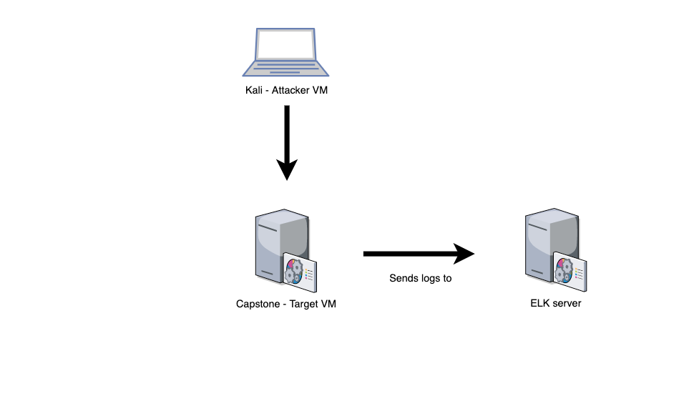
Network Topology
[Insert Here]
Use draw.io to create a diagram of the network.
Add your diagram to this slide and fill out the data in the sidebar.
Network
IP Range: 192.168.1.0/24
Netmask: 255.255.255.0
Gateway: 192.168.1.1
Machines
IPv4: 192.168.1.90
OS: Linux
Hostname: Kali
IPv4: 192.168.1.100
OS: Linux
Hostname: ELK
IPv4: 192.168.1.105
OS: Linux
Hostname: Capstone

Slide 5

Red Team
Security Assessment
‹#›

Slide 6
Recon: Describing the Target
Nmap identified the following hosts on the network:
Hostname | IP Address | Role on Network
Red Team vs Blue Team VM | 192.168.1.1 | Windows VM Environment (This environment contains the following VMs)
Kali | 192.168.1.90 | Attacking VM
Elk | 192.168.1.100 | Elk Server used to view logs in Kibana
Capstone | 192.168.1.105 | Victim (Target) VM

Slide 7
Vulnerability Assessment
The assessment uncovered the following critical vulnerabilities in the target:
Vulnerability | Description | Impact
Sensitive Data Exposure OWASP Top 10 #3 || Critical | The secret_folder is publicly accessible, but contains sensitive data intended only for authorized personnel. | The exposure compromises credentials that attackers can use to break into the web server.
Unauthorized File Upload Critical | Users are allowed to upload arbitrary files to the web server. | This vulnerability allows attackers to upload PHP scripts to the server.
Remote Code Execution via Command Injection OWASP Top 10 #1 || Critical | Attackers can use PHP scripts to execute arbitrary shell commands. | Vulnerability allows attackers to open a reverse shell to the server.s

Slide 8
Exploitation: Exposure of Sensitive Data
01
Tools & Processes
nmap tool: used to scan the network
Browse the web server for any sensitive information
dirb tool: used to map URLs on the server
02
Achievements
A “/secret_folder/” directory on the web server was revealed.
The directory is password protected, but vulnerable to a brute-force-attack.
The login prompt revealed a username (ashton) that can be used for a brute-force-attack.

Slide 9
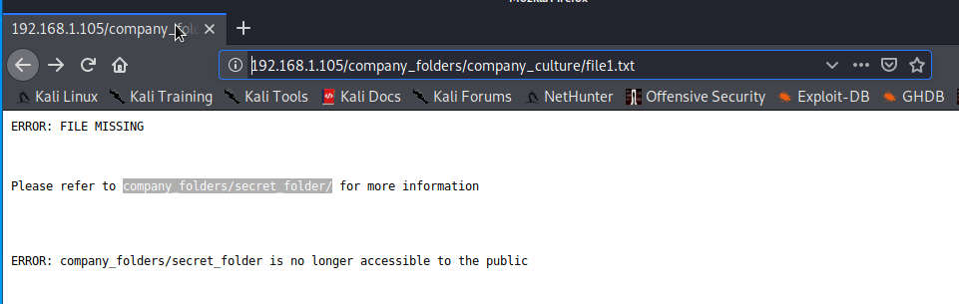
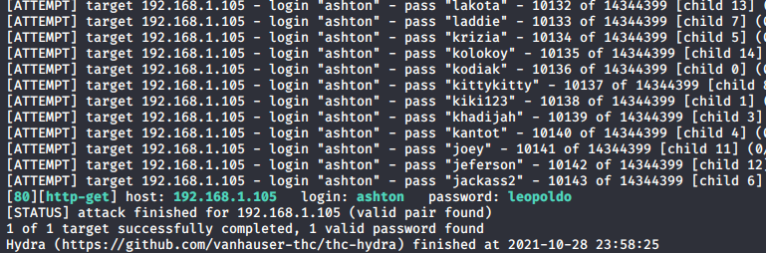
Exploitation: Exposure of Sensitive Data
03
Running a “Hydra” brute-force-attack against the company_folders/secret_folder revealed the employee’s (ashton) password.
Hydra command used against the hidden directory /company_folders/secret_folder/:
Discovery of the hidden directory [above].
hydra -l ashton -P rockyou.txt -s 80 -f -vV 192.168.1.105 http-get http://192.168.1.105/company_folders/secret_folder/
A successful brute-force-attack using the hydra command revealed the user’s password [above].

Slide 10
Exploitation: Unauthorized File Upload
01
Tools & Processes
Crack stolen credentials using a simple online hash tool. These credentials were then used to connect to WebDAV.
Create a custom reverse shell payload with msfvenom.
Upload shell to the server via WebDAV.
02
Achievements
Using the credentials from the cracked hash, we are able to gain access to the WebDav connection.
This unauthorized access allows us to upload malicious files, as well as removing important files from the server.

Slide 11
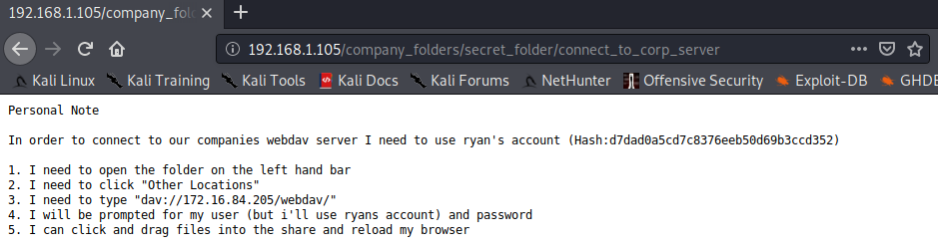
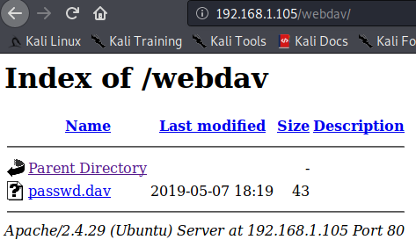
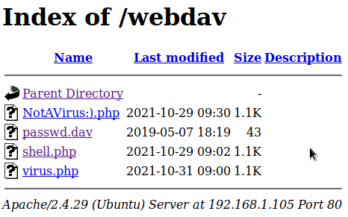
Exploitation: Unauthorized File Upload
03
Uploading malicious files to the server can come with a lot of consequences.
One of the files uploaded to the server included a reverse shell script. A reverse shell script can allow an attacker to establish a meterpreter session with Target VM.
Discovery of directory with instructions on how to connect to WebDav server, along with Ryan’s password hash [above].
Picture [left] was captured before the attack. Picture [right] was captured after the malicious files were uploaded to the server.

Slide 12
Exploitation: Remote Code Execution
01
Tools & Processes
Navigate to the webpage and click on the uploaded shell.
Establish a meterpreter session with the Target VM using msfconsole.
Use shell to explore and compromise the Target VM.
02
Achievements
Leveraging the RCE allows us to open a Meterpreter shell to the target.
Once on the target, the full file system is available for exploration.

Slide 13
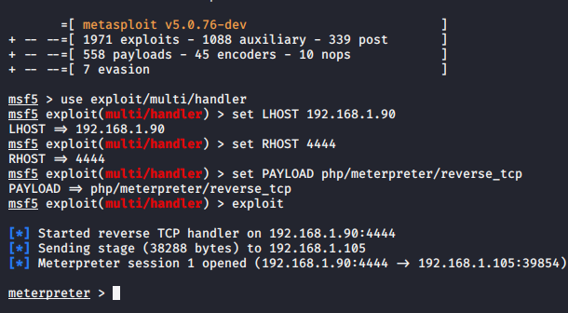
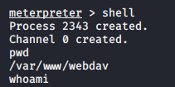
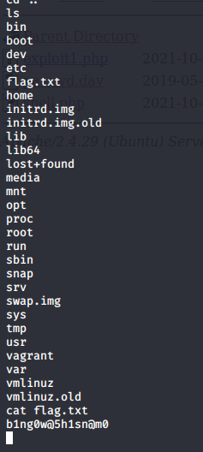
Exploitation: Remote Code Execution
03
Achieving a shell on the target allows us to display all files and capture the flag.
Although, there how many things a malicious hacker can do once a reverse shell is established on the Target VM.
Meterpreter session established [above].
A meterpreter session allowed us to achieve a shell on the target [above].
Running shell commands on the target allowed us to find and capture the flag (flag.txt) [above]

Slide 14

Blue Team
Log Analysis and Attack Characterization
(Kibana)
‹#›

Slide 15


A considerable amount of data is available in the logs.
We are able to view these logs with Kibana.
Specifically, evidence of the following was obtained upon inspection:
Traffic from attack VM to target, including unusually high volume of requests
Access to sensitive data in the secret_folder directory
Brute-force attack against the HTTP server
POST request corresponding to upload of shell.php
‹#›

Slide 16

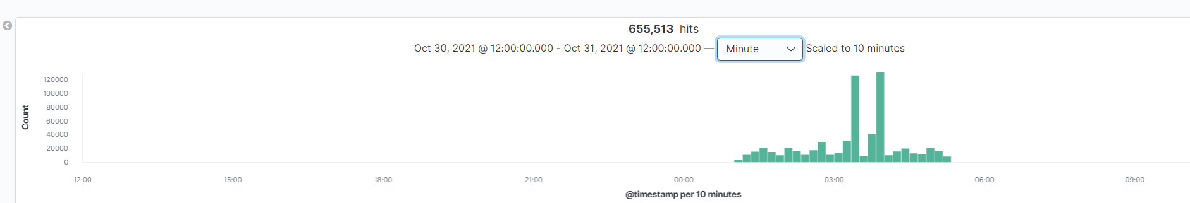
Analysis: Identifying Suspicious Behavior
Using Kibana (or other SIEM tools) can help us view and identify suspicious activity on the server.
A large spike in traffic can raise concerns of a possible cyber attack.
The graph below helped us decide what time the suspicious activity occurred.
A massive spike in web traffic occurred on October 31, between the hours of 3 and 5 A.M..

Slide 17
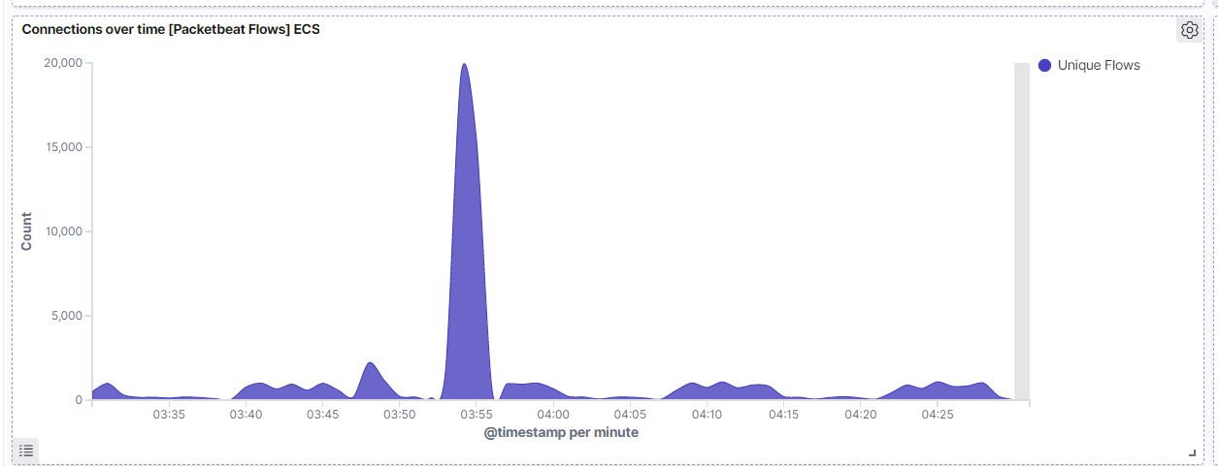
Analysis: Identifying Suspicious Behavior (cont.)
Zooming in from the last graph, we are able to see the exact time the spike in traffic occurred.

Slide 18
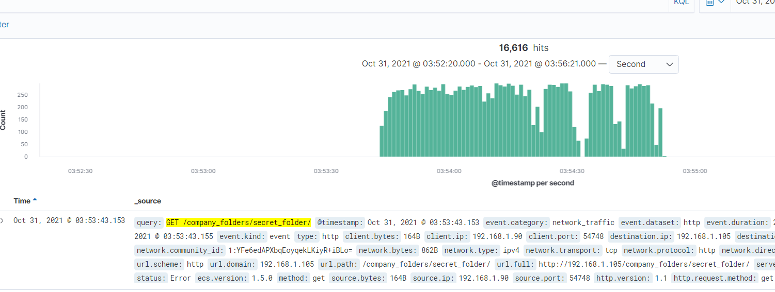
Analysis: Finding the Request for the Hidden Directory
Using the Kibana Dashboard and Discovery features, we were able to determine which directory was requested most during the traffic spike.
The hidden directory, /company_folders/secret_folder/, was requested more than 16,000 times within a 5 minute time span. All of these requests came from IP address 192.168.1.90 (Kali VM).

Slide 19
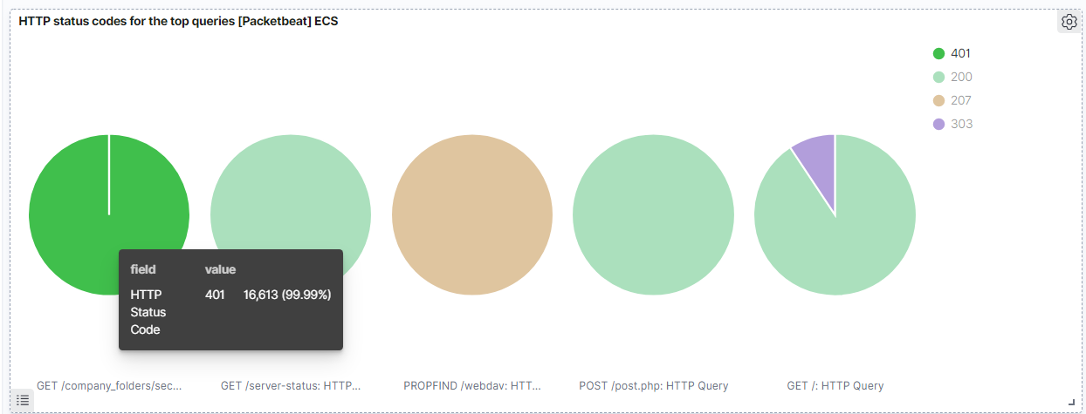
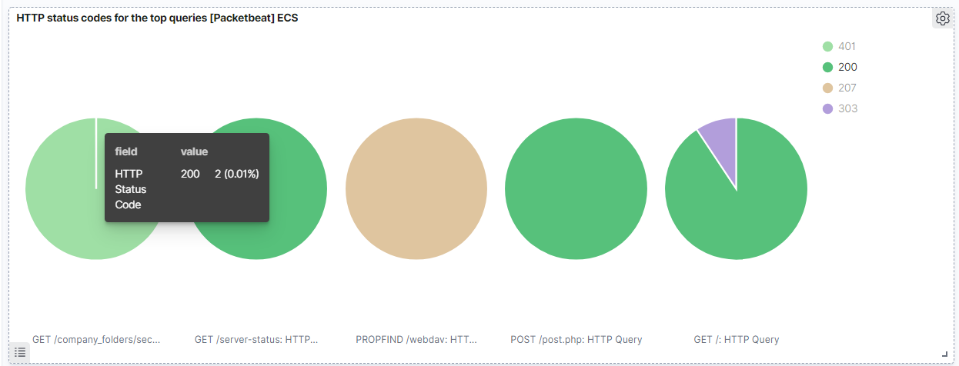
Analysis: Uncovering the Brute Force Attack
The requests that were made for the hidden directory were captured and recorded as logs. Within these logs we were able to determine how many of those requests failed (401 response code) and how many were accepted (200 response codes).
16,613 http requests
were declined
Only 2 http requests
were accepted

Slide 20
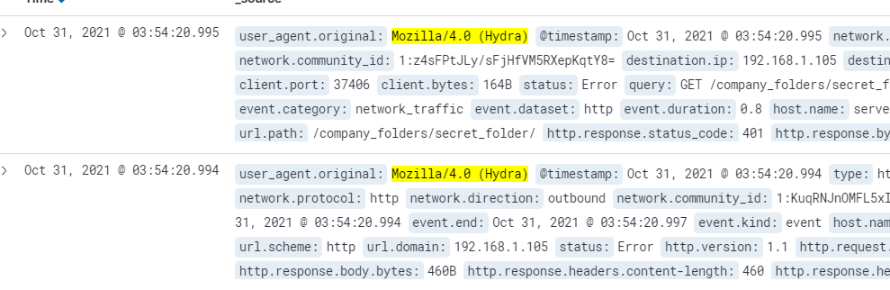
Analysis: Uncovering the Brute Force Attack (cont.)
Within these logs, “Hydra” was identified in the user_agent.original field. We knew ahead of time the hydra command was used during the Red Team phase . However, “Hydra” is a popular linux tool command used to conduct Brute-Force-Attacks. We can use this information later when creating alerts.

Slide 21
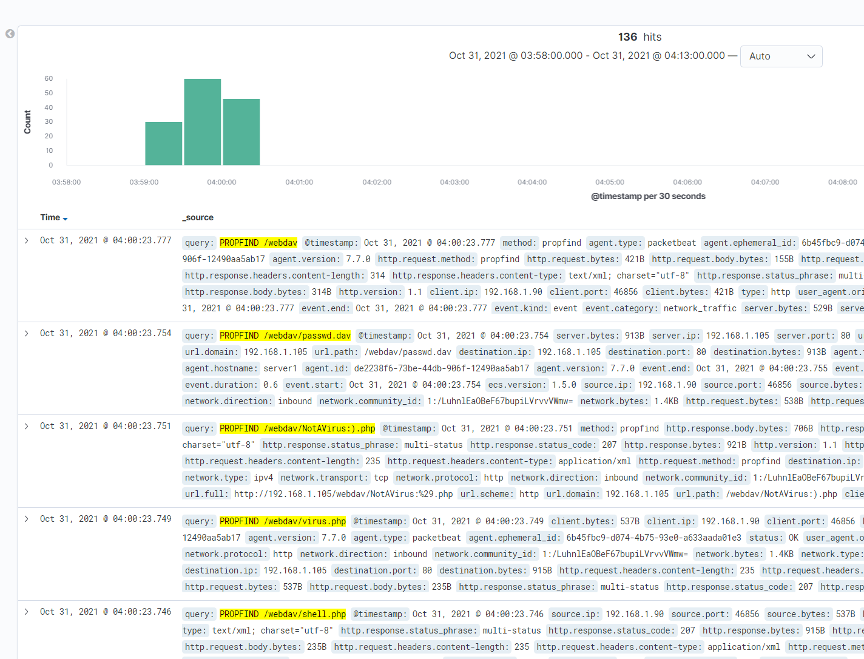
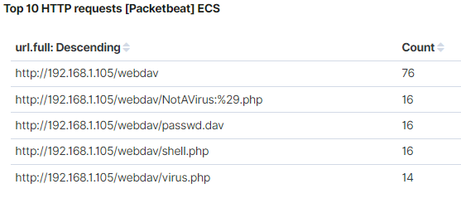
Analysis: Finding the WebDAV Connection
After the Brute-Force-Attack on the hidden directory, we were able to find multiple new files requested and uploaded to the WebDav server, including the malicious Virus.php file (approximately around 4 A.M.).

Slide 22
Blue Team
Proposed Alarms and Mitigation Strategies
‹#›

Slide 23


Port Scans can help cyber criminals enumerate vulnerabilities on a network.
Blocking these scans can help prevent future cyber attacks.
‹#›

Slide 24
Mitigation: Detecting/Blocking Port Scans
What kind of alarm/s can be set to detect future port scans?
# of Requests per Second
What threshold would you set to activate this alarm/s?
Alarms should fire if a given IP address sends more than 10 requests per second for more than 5 seconds
What configuration can be set on the host to block unwanted access?
The local firewall can be used to throttle incoming connections
ICMP traffic can be filtered
An IP allowed list can be enabled

Slide 25
Mitigation: Finding the Request for the Hidden Directory
What kind of alarm/s can be set to detect future unauthorized access?
Allow authorized IP addresses. Trip the alarm if an IP not on the allow list attempts to connect
What threshold would you set to activate this alarm/s?
This is a binary alarm: If the incoming IP is not allowed, it fires. Otherwise, it does not.
What configuration can be set on the host to block unwanted access?
Access to the sensitive file can be locally restricted to a specific user. This way, someone who gets a shell as, e.g., www-data will not be able to read it.
File encryption

Slide 26
Mitigation: Preventing Brute Force Attacks
What kind of alarm/s can be set to detect future brute force attacks?
# of Requests per Second
“Hydra”, or a known password hacking tool/command, shows up in logs.
What threshold would you set to activate this alarm/s?
More than 100 requests per second for 5 seconds should trigger the alarm
Anytime the word “hydra” shows up in a single packet.
What configuration can be set on the host to block brute force attacks?
Configuring strict lockout policies on the network. For example, an account is locked after 5 failed attempts within a 5 minute period. A user would need to wait a pre-set duration of time (or contact the company’s IT department to unlock).
Configuring fail2ban or a similar utility would mitigate brute force attacks

Slide 27
Mitigation: Detecting the WebDAV Connection
What kind of alarm/s can be set to detect future access to this directory?
A source coming from an unknown IP address.
What threshold would you set to activate this alarm/s?
Trip the alarm whenever someone accesses the webdav directory.
Any user using an unknown IP address would trip the alarm.
What configuration can be set on the host to control access?
Restrict access to users from known IP addresses.
Completely remove the ability to WebDav connection on the company’s webpage.

Slide 28
Mitigation: Identifying Reverse Shell Uploads
What kind of alarm/s can be set to detect future file uploads?
Set an alarm to notify us upon receipt of any POST request containing data of a disallowed file type, such as a .php file.
Port 4444 is a the default port for establishing meterpreter sessions. Set an alarm to trip whenever port 4444 is being used by the source.
What configuration can be set on the host to block file uploads?
Write permissions can be restricted on the host.
Allow only known IP addresses the ability to upload files to the server.
Uploads can be isolated into a dedicated storage partition.

